Slide 1
Teaching computer and data science with
literate programming tools:
How I made Emacs + Org-mode
mandatory in all my courses
Marcus Birkenkrahe - Lyon College EmacsConf 2023
Notes:
Welcome to my talk, which is pre-recorded so please don't blame me if I come across as wooden and humorless. It's hard to work up any emotion when talking to a mechanical eye. Of course, I am German so I'm pretty wooden and humorless to begin with.
What else do you need to know about me? Not much, I suppose, except that I've been an Emacs user on and off since my days as a graduate student of theoretical physics in the 1990s.
I picked Emacs and Org-mode up for teaching during COVID when I had time on my hands and when the teaching and learning needs shifted because of the exclusive online teaching.

Slide 2
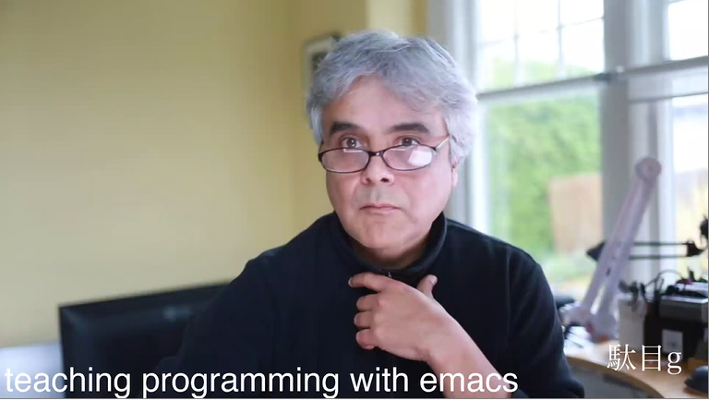
https://emacsconf.org/2021/talks/teach/
Notes:
My interest in this topic began with an EmacsConf talk given by Daniel German from the University of Victoria in Canada in 2021.
He demonstrated in detail how he uses Emacs and Org-mode to prepare and deliver lectures on different programming languages.
This gave me the idea to try the same thing with my students, with an important alteration: I wanted to force them to use Emacs and Org-mode just as most computer science instructors force their students to use whatever they're using when they develop their material.

Slide 3
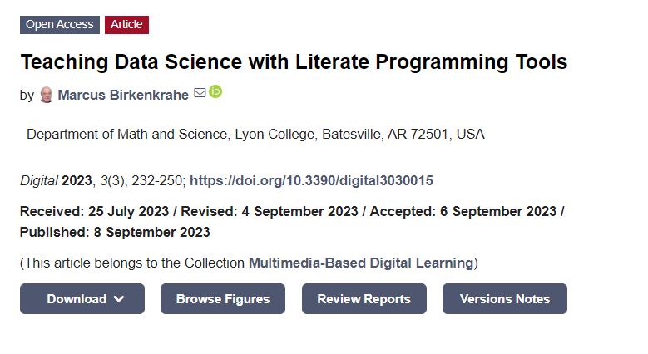
https://doi.org/10.3390/digital3030015
Notes:
I carried my plan out and mandated Emacs and Org-mode as the only programming platform and IDE for three consecutive terms in all my courses, 9 courses in total. I'll give more details later.
I published my results as a case study in September of this year, and it contains the missing bits that I cannot talk about today, especially regarding the methodology, assessment etc. Please use the Q&A to inquire about such details.

Slide 4
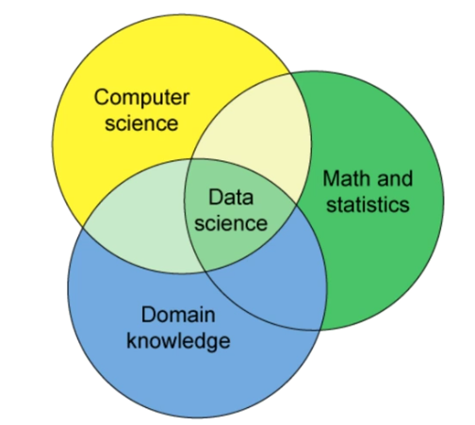
What is
data
science?
Computing
+ Math/Stats
+ Your Stuff
Notes:
I probably don't have to explain what computer science is but not everyone may know what data science does. I teach courses in both disciplines and the boundaries between them are blurred, so much of what I'm saying about data science will also be relevant for computer science.
Conceptually, data science is an interdisciplinary affair that intersects with computer science and with whatever it is that the data scientist or his or her clients know well - their domain.
Because of this interdisciplinary character, and because their focus is on the data rather than only on algorithms or mathematics, successful data scientists need to be more broadly educated than specialists in computer science or statistics.

Slide 5
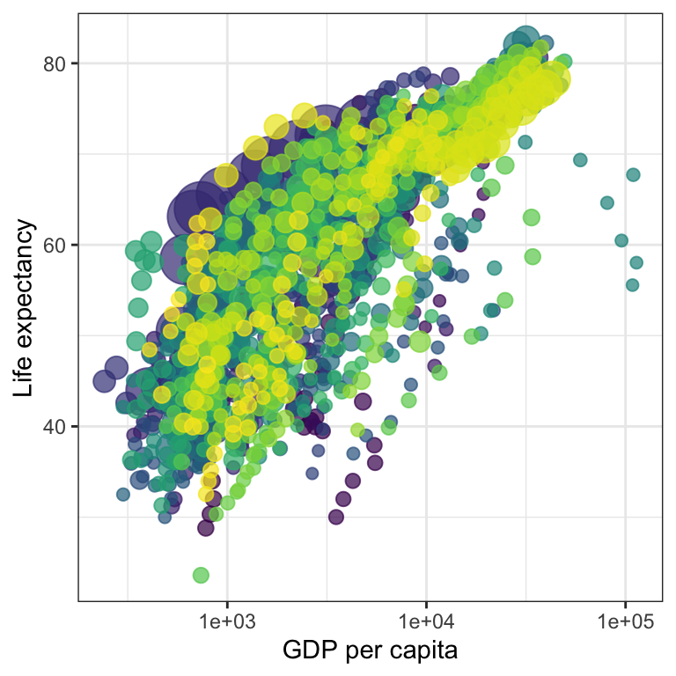
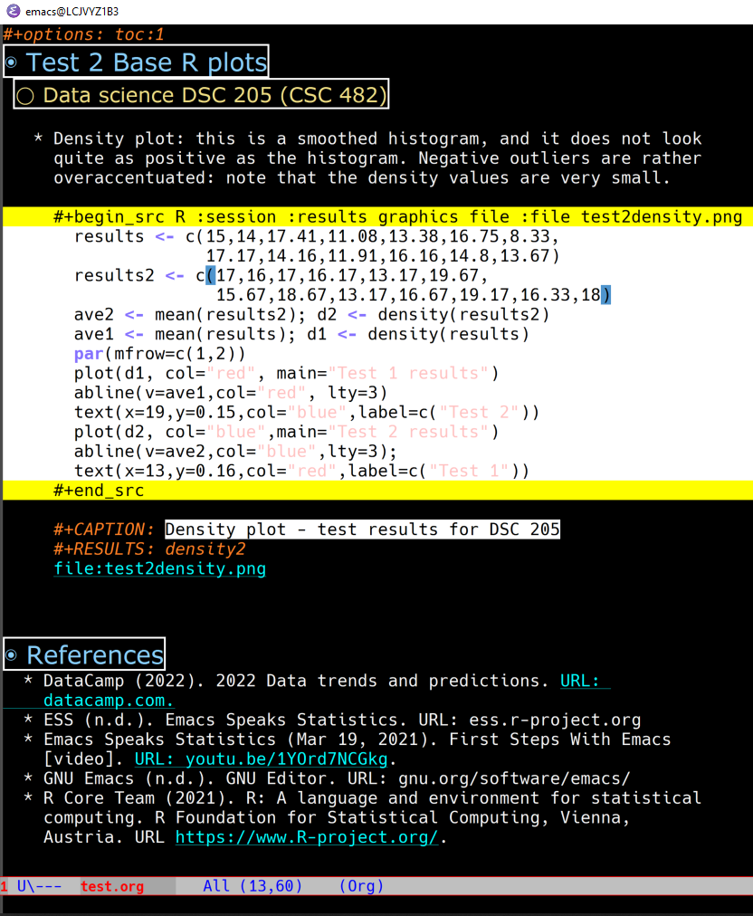
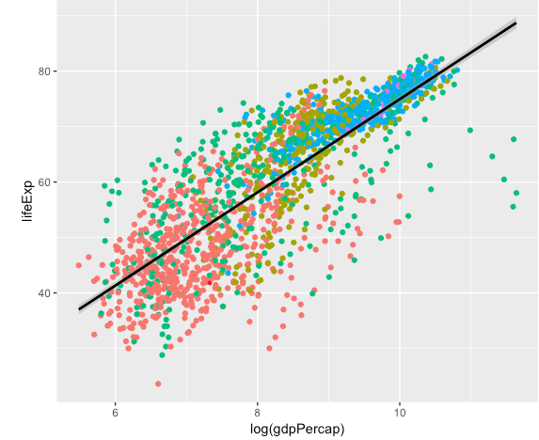
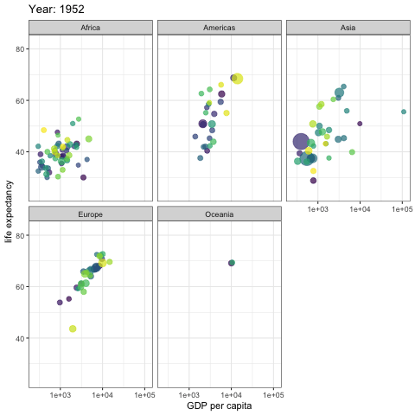
What is data science?
data + code + stats = story
Notes:
In particular, there is a need to master the entire so-called data science pipeline from data cleaning over coding to statistical modeling and data storytelling through visualization.
This is why until recently, data science was a graduate-level education only for software engineers, computer scientists, statisticians, psychologists, biologists, business people, or whoever took a special fancy to data in their chosen field.
Especially with the growing interest in machine learning, this has changed and now we train, or try to train, data scientists in undergraduate programs as well.

Slide 6
Computer science is a craft
Take it apart
Learn tools
Fix many cars
Mechanical literacy
Inferential thinking
Image source: The Atlanta Journal-Constitution, Dec 23, 2012
Notes:
I think this is true for all areas of computing - from software engineering to data science: they are mostly taught and learnt like a craft rather than a science - not through research but through drill.
The elements of this drill can be illustrated by learning how to fix cars. They include: taking a problem apart with the tools you already know, learn a lot more tools in the process of doing that, then solve many, many problems of increasing difficulty while being or getting "literate", as it were, about the mechanics of computing, including the hardware, the infrastructure, and develop a way of thinking that allows the learner to identify patterns to solve new problems better and faster.
Unlike learning how to fix cars, all of the objects of our interest, both hardware and software, are evolving rapidly: in this field, radical innovation is the rule, not the exception.

Slide 7
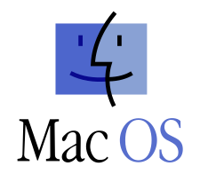
The problem
Computers are seen as bricks with buttons
Students cannot find downloaded files
Cannot distinguish between browser, PC, network, cloud, client, server …
Convenience, not customization, rules
Machines have all the power
Notes:
The problem that I identified is that students, especially undergraduate students in computer and data science, often no longer understand their infrastructure. Here are a few examples of the problems that students have:
They do not understand computing architecture (except in theory)
They cannot navigate their way around their own computers
They don't understand the value or the issues of networks
They are more interested in convenience than customization
And as a result, the machines, which they are meant to control, have all the power, though passively of course (for now anyway).

Slide 8
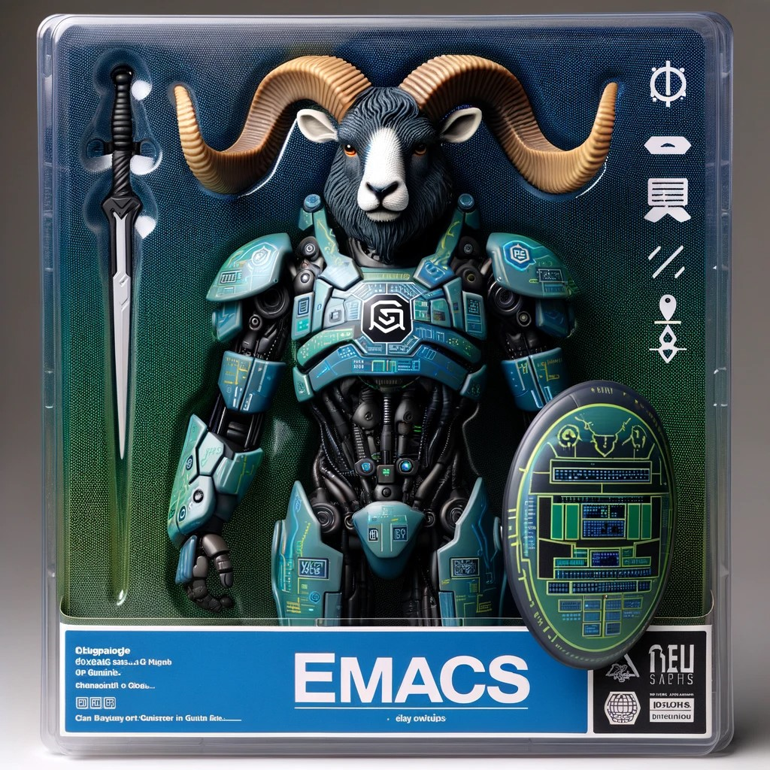
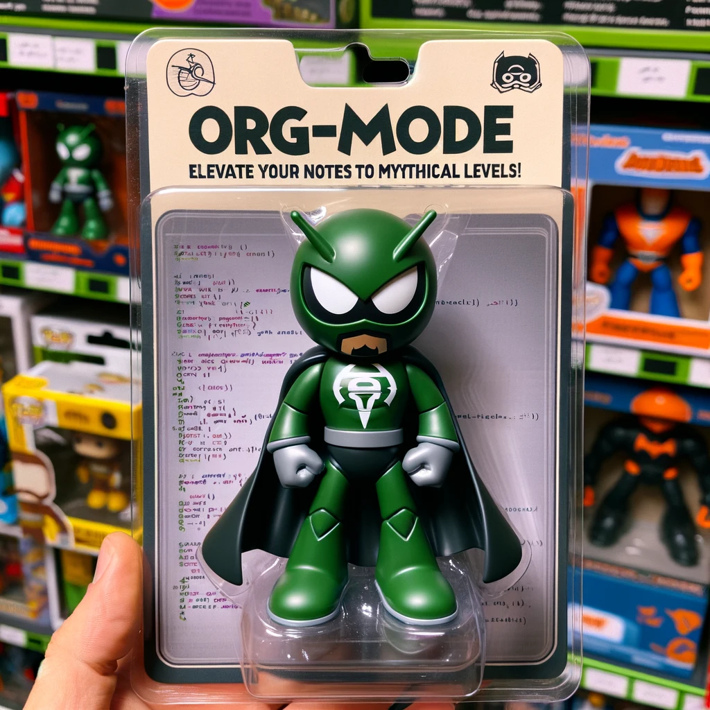
The solution: Emacs + Org-mode
+
Notes:
Enter Emacs, the self-extensible operating system disguised as a text editor.

Slide 9
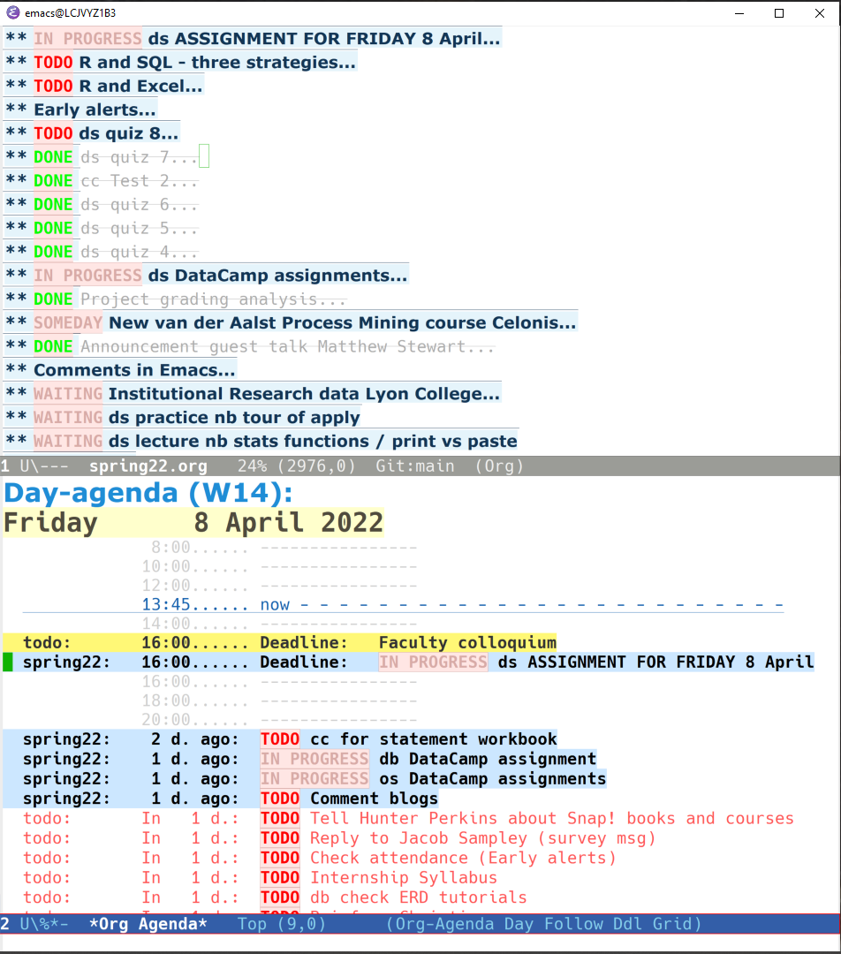
GNU Emacs
Programmable platform
Self-documenting
Fully extensible & transparent
Text editor + operating system
Keyboard-heavy
Lisp machine
Free software
UNIX / Linux methodology
Created 1975, launched 1985
Used by me since 1991
Hard to learn, easy to use
Notes:
You're at EmacsConf so I don't have to tell you what Emacs can do. Here is a rundown of some of its most important properties on the right, and an Org-mode file excerpt on the left.
What you may not know is how to onboard students who have, at the start, no interest whatsoever in leaving their comfort zone, which is defined by a lifetime of Windows, preconfigured graphical interfaces and software bloat.
In fact, when I started this, I wasn't very hopeful but the results have made me be even more optimistic than I already am by nature!

Slide 10
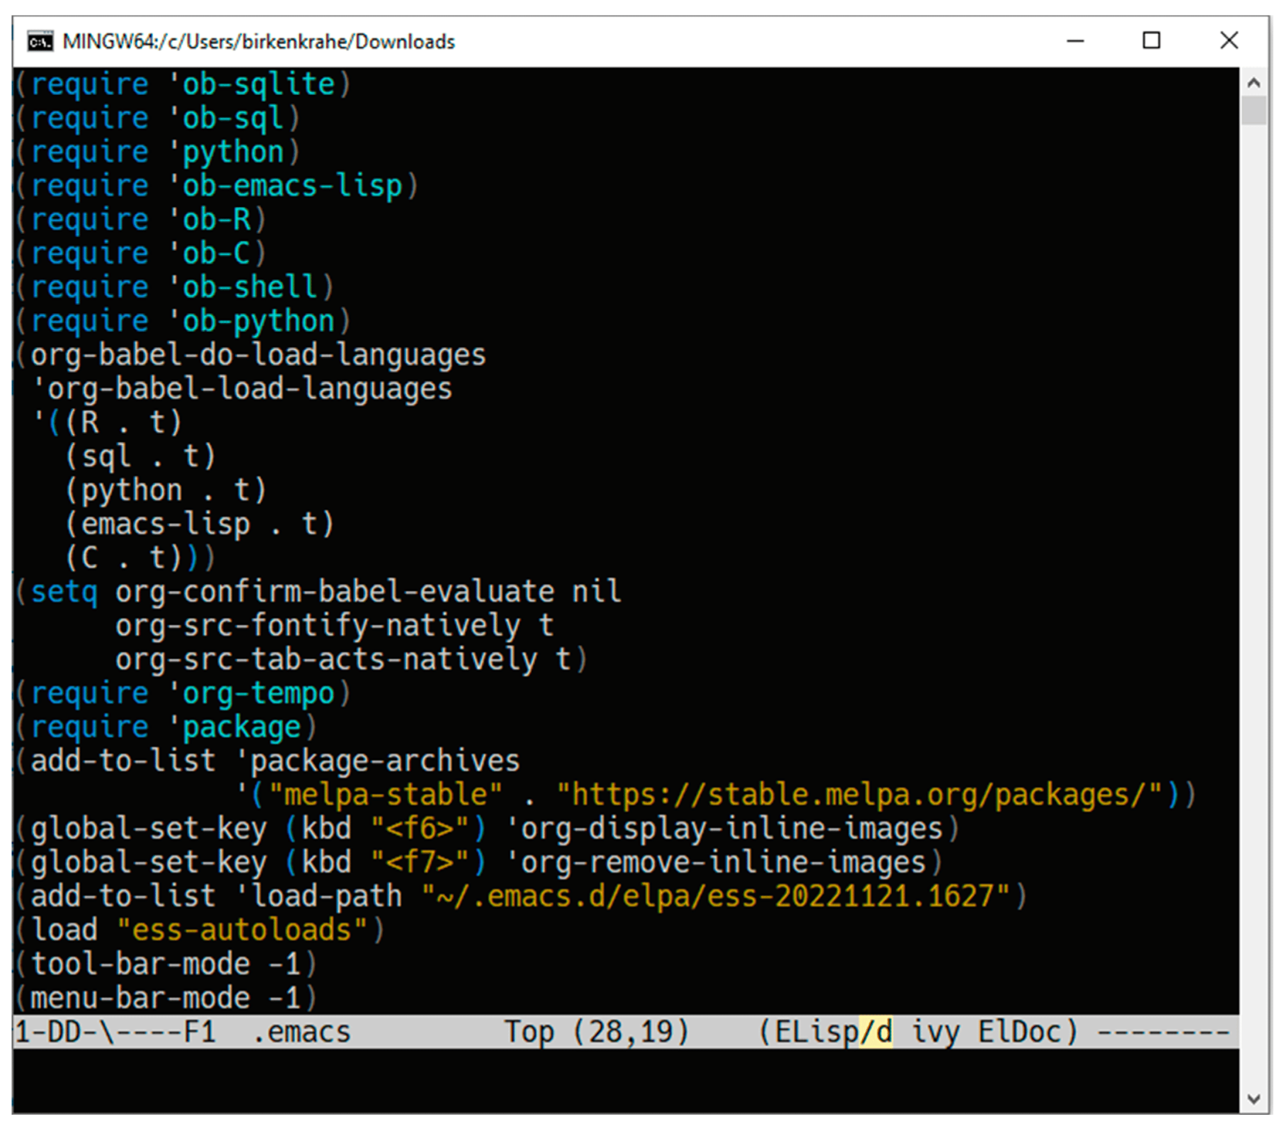
Emacs configuration file
Run C/C++, R, SQL, SQLite, Python and bash
Update Emacs from the melpa repository
Create code blocks with skeleton commands
Autoload ESS
Disable toolbar and graphical menu bars
Notes:
To rein in your expectations, you cannot do entirely without configuring the students' experience. An important part of this is the initial Emacs configuration shown here.
The minimal configuration file:
Allows the students to run code in C/C++, R, SQL, SQLite, Python and bash.
Update Emacs packages from the stable melpa repo.
Create code blocks easily with skeleton commands, e.g. <s that expands into #+begin_src ... #+end_src.
Autoload the Emacs Speaks Statistics package to run R in Emacs.
Disable toolbar and graphical menu bars to encourage exclusive use of the keyboard to control Emacs.

Slide 11
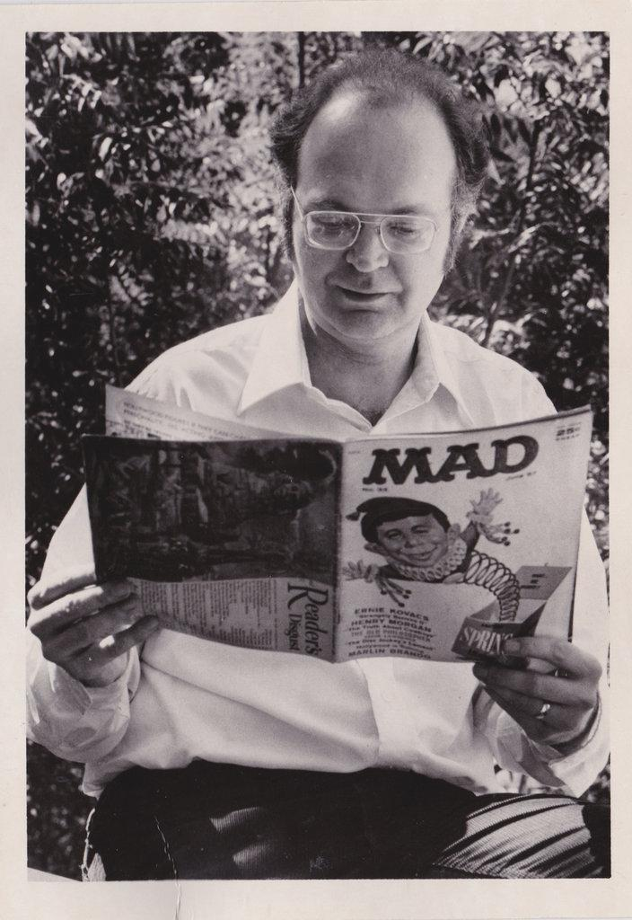
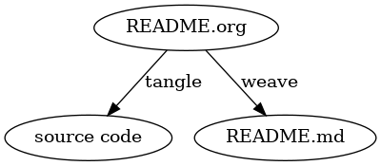
What is literate
programming?
Story + code =
source + documentation
Image source: adamard.com
Notes:
Org-mode, included in Emacs since 2006 as a major mode, is a structured, plain-text format with notebook live code execution.
It is an ideal platform for literate programming, programming that intermingles code, documentation, and output within a single document. This methodology was conceived by Don Knuth in 1984 and is therefore even older than Emacs itself.

Slide 12
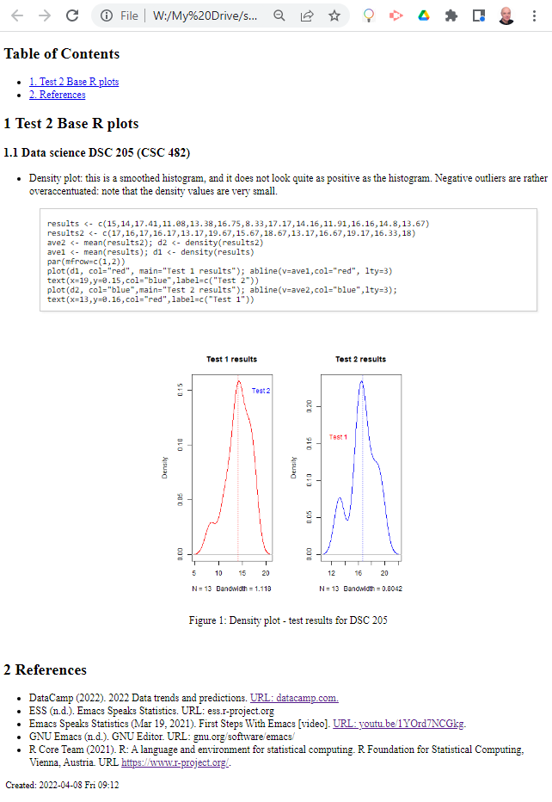
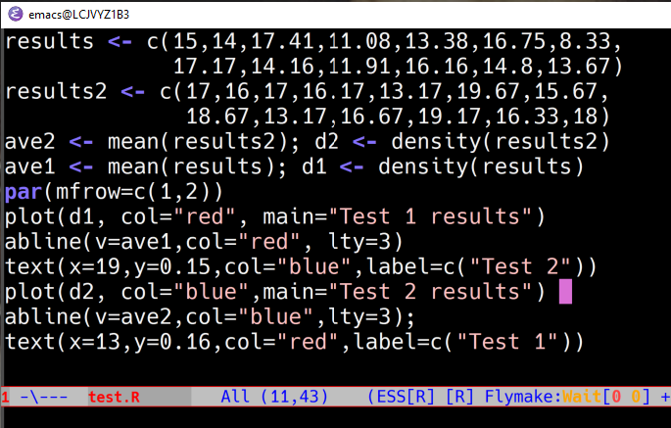
What is literate programming?
Humans
Machines
Story + code = source code + documentation
Notes:
The main purpose of literate programming is not only to make code or documentation or output more manageable but to allow humans to create a data story with ease from a single source.
I actually did all my programming in a literate way even in the early 1990s using Norman Ramsey's noweb preprocessor. And I still use it inside Org-mode today. noweb allows you to tangle code from within an Org-mode file as a self-standing file much like Org-mode's edit functions, which export code blocks into buffers in whatever language the code block is written.

Slide 13
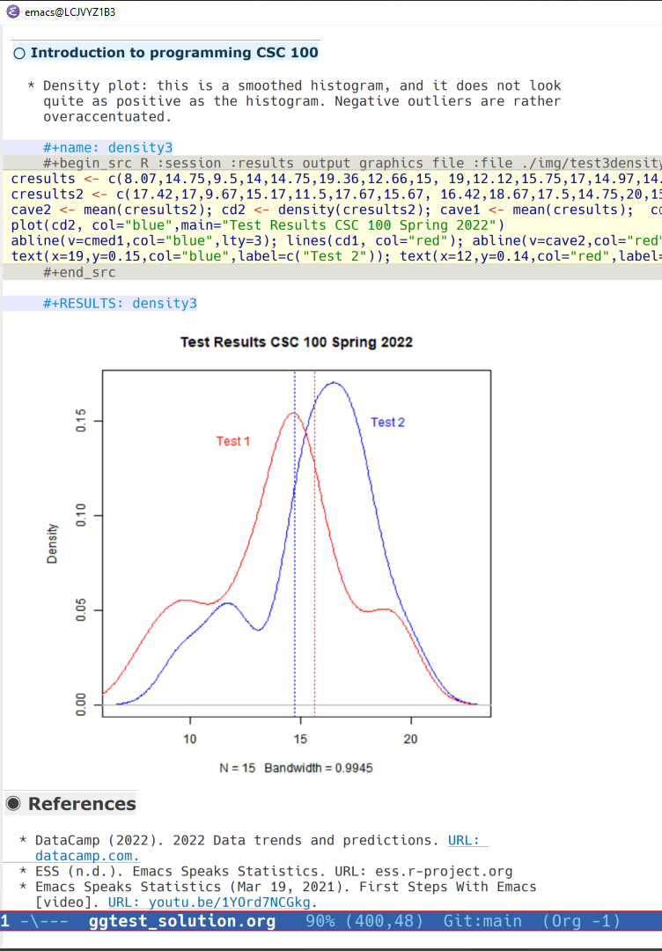
Emacs as a literate programming tool
Execute code blocks
Code in 43 programming languages
Display results
Interact with shell
Extract source code
Render documentation
Manage tasks & projects
5,000 add-on packages
Notes:
In data science, interactive notebooks in one of the interpreted languages Julia, Python or R dominate - the basis technology is that of Jupyter notebooks, which use a spruced up shell, e.g. IPython for Python, with an option to add SQL cells.
Org-mode inside Emacs has a number of advantages over these notebooks. Two stand out particularly:
Different languages can be mixed as shown in the image while in Jupyter notebooks, a notebook is limited to running a kernel in one language only.
The content of the notebook, its document, code or output part, can be exported in a variety of formats, make it much easier to share with others, and to use one's work in different reporting formats.

Slide 14
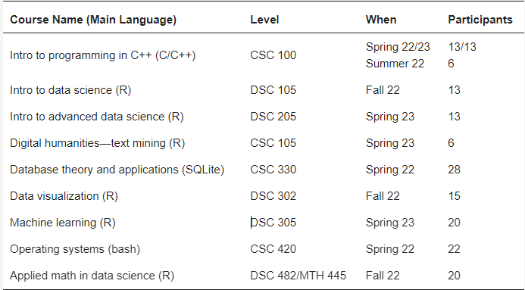
Case study: basic setup
Introductory to advanced
Different computing applications
Taught over 3 terms
6-28 participants
Used GitHub, Canvas, DataCamp
The material of all of my courses is available online at github.com/birkenkrahe
Notes:
Here are the overall results of the case study:
Courses ranged from introductory to advanced.
The topics covered different programming applications.
The courses were taught over a period of 3 terms.
There were between 6 and 28 participants per course.
Tools besides Emacs: GitHub as the main repository, DataCamp for structured online lessons and exercises, Canvas as a learning management system, and Zoom to record sessions.
The material for all these courses is openly available on GitHub.

Slide 15
Emacs + Org-mode notebooks used for:
Code along lectures
Home assignments
Practice in class
Student projects
GitHub repository
Notes:
I'm now going to briefly comment on the most important aspects of using Emacs + Org-mode in and outside of class.
Essentially, these two were used all the time for almost everything that students were doing in and outside of class.
The only exception were multiple choice tests and online assignments on the DataCamp learning platform in the data science courses.

Slide 16
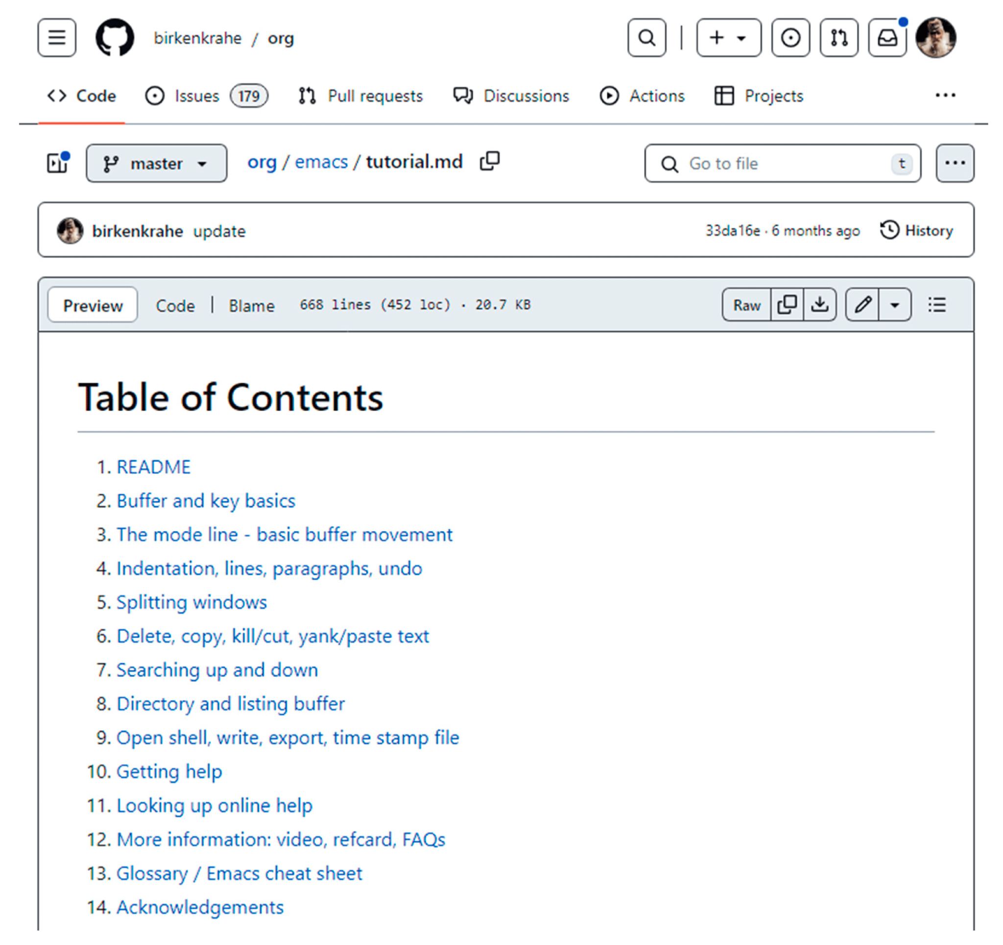
Onboarding: simplified Emacs tutorial
Notes:
To facilitate onboarding, I developed a simplified Emacs tutorial focused on the basics of literate programming with Org-mode:
Navigation and major modes
Managing files and buffers
Customizing the interface
Keyboard shortcuts
By the end of the 2nd week, most students were able to use Emacs and Org-mode competently for their assignments in and outside of class.

Slide 17
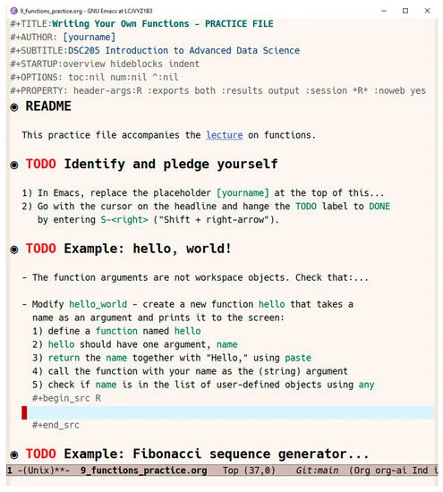
Instruction +
Interaction
Emacs + Org pre-installed
All lectures code-along
Notes:
All classes were taught physically in a computer lab. Emacs with Org-mode and necessary languages were pre-installed on the computers, which ran Windows (like most of the students' personal computers).
A typical class involved a lecture delivered by me in Emacs as a code along: the students would get an Org-mode file with all code removed.
Students submitted home assignments as Org-mode files complete with documentation, code, and sample output.
Working this way made classes highly interactive: students were busy coding, and learning to control their environment better all the time.

Slide 18
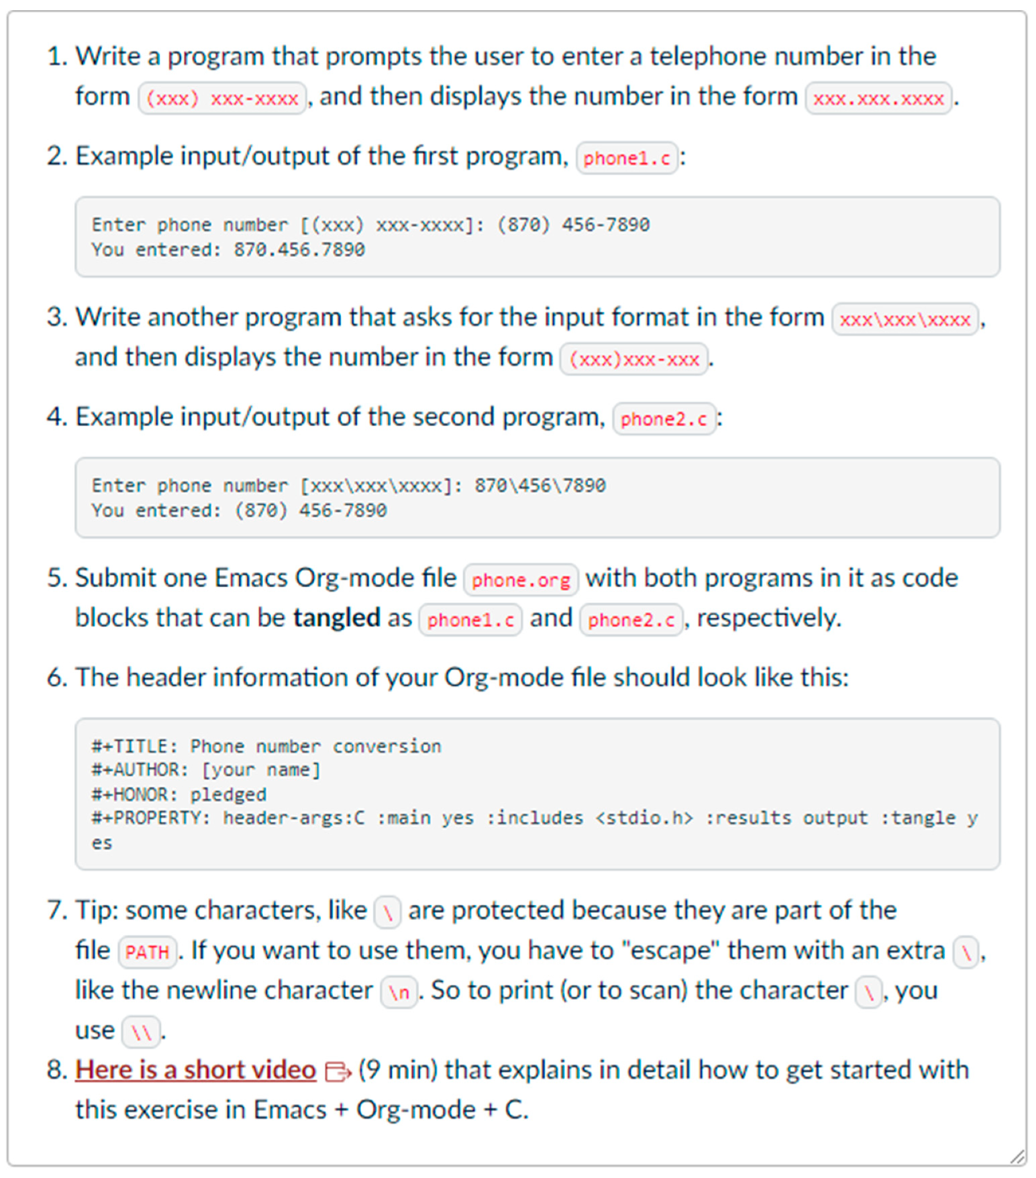
Assignments + Projects
Submit literate Org-mode files
Communicate throughout
Notes:
In my classes, the students have to complete an independent, agile research project using an adaptation of Scrum. You can find examples of these high octane projects in my paper.
Using literate programming for the projects provided some unique benefits: by having to continuously interweave documentation, references, and output alongside functional code, students learnt to communicate their work throughout the term, in varying stages of completion, from research question to prototype to finished product.

Slide 19
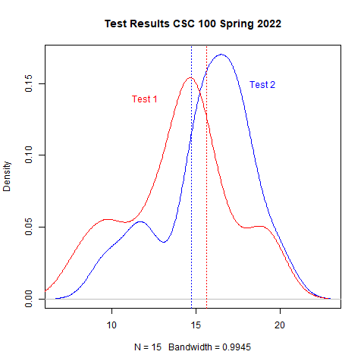
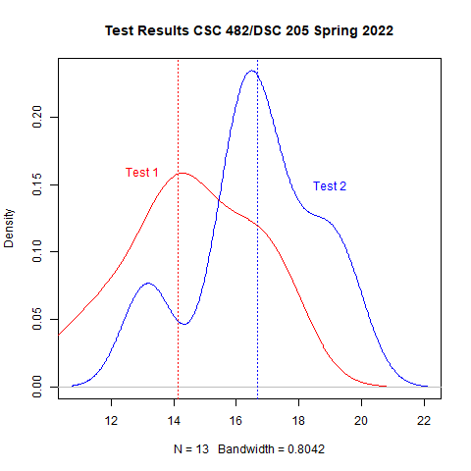
Before | After introducing literate programming
Before | After introducing literate programming
Notes:
The two graphs show how the test results of the students in two different courses changed from before to after introducing literate programming with Emacs and Org-mode.
It was this performance improvement, apart from the students voicing their support that made me extend the Emacs experiment after the first term.

Slide 20
Overall results positive:
Emacs hard for all but all succeeded across all courses
Documentation results uneven but higher quality than ever
Interactivity praised by all students
Computing and infrastructure competences much improved
Notes:
The courses were formally and informally evaluated by the students. See my paper for explicit student comments. Here I'm giving you only the summary:
Emacs proved to be hard to learn for some but all succeeded in all courses, independent of the level of previous knowledge and skill.
Documentation practices remained uneven but they were overall much higher than in classes without use of Emacs and Org-mode.
The interactivity enabled through Emacs was praised by students.
Computing, file and data handling competences increased massively.
In the published paper, I expressed more doubt than I feel now about this experiment.

Slide 21
Conclusion & outlook
Immersion and interaction is everything
Emacs + Org-mode perform well as central literate programming platform
Pre-configuring and onboarding are important to train students quickly
Notes:
In the current term I have abandoned Emacs for online Jupyter notebook installations that have generative AI support from ChatGPT integrated, because I wanted to try it, but I regret that decision now - the AI advantage does not make up for the loss of immersion that Emacs and Org-mode deliver.
And when learning computer and data science, immersion is everything. The best students will aim at immersion anyway, but for the majority of students, immersion must happen in class.
In the paper, I also speculated on the impact of low code, no code and AI coding assistants. My general view is that the arrival of these tools makes literate programming as an immersive technique focused on teaching a broad range of skills even more important.

